Slide 1

Welcome!

Slide 2
Welcome!
Vinod Anantharaman
Director of Strategy & Biz Mgmt., IMML

Slide 3
Checklist!
Laptop stickers
Wrist pads
Handouts at \\CT01\hackathon\Resources
Schedule
TLC Info
R Info
*** Azure ML Studio use infeasible today – blocked on bugs ☹☹☹

Slide 4
Track #1: Freeform Track
You get to work on any problem of your choice
Be articulate about the customer problem/scenario
Solution must use ML
Winners determined by jury – Prototype/Demo expected
FF Track Teams:
→ Move to BAKER at 9:30AM
→ Sign up for a demo slot by 2:00PM (3 min per team, max)
→ Complete your demos between 2:30 to 4:15PM

Slide 5
Track #2: Contest Track
BGs pitched problems, 1 “winning problem” selected
Customer will unveil problem in their own words…
Goal: Achieve highest %accuracy
“Winners” determined by automated script
Contest Track Teams:
→ Remain in HOOD
→ More info follows…
→ Last submission at 4:00PM

Slide 6

Contest Track Problem:
Help Auto-Route User-Initiated Feedback (UIF) for Cortana
Ashwin, Senior SDET, Cortana
Gabriel, Senior SDET, Cortana
Guo-Wei, Principal SDE, IMML

Slide 7
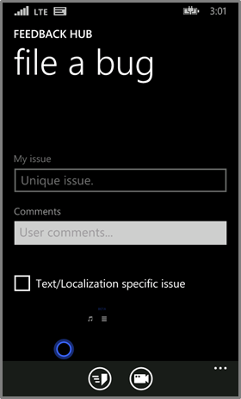

Windows Phone UIF Statistics
UIF = User Initiated Feedback
Key Statistics
53K self-host bugs opened
14K Cortana bugs (~25%)
90+ Cortana bugs/day
1350 man hours to triage
50% of all UIF bugs were rerouted
In a mobile first, cloud first world, routing bugs manually through highly distributed systems is labor intensive and time consuming

Slide 8
Cyber-Triage!
Rich set of data collected in each UIF
General Details
Who
When
Branch
Build
Device
Extended Data
Description
zTrace log
Screenshot
Using ML, can we more accurately predict the area path of an incoming bug and significantly reduce triage overhead and bug turn-around time?

Slide 9
What to Expect in Today’s Contest
3 phases
It’s all about Data
Am I the winner?

Slide 10
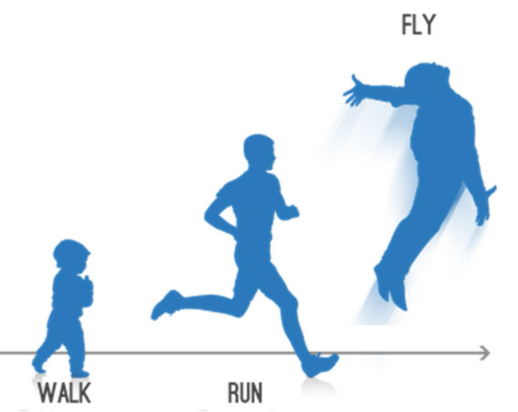

3 Phases
Walk: 9:30AM – 11:30AM
Run: 11:30AM – 2PM
Fly: 2PM – 4PM
Submissions could be done at any time
More data will be shared at beginning of each phase

Slide 11
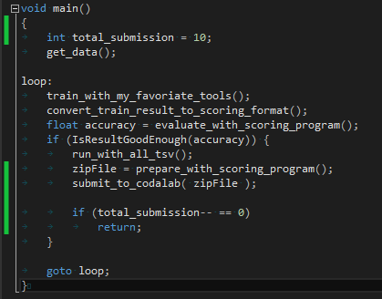
Each Phase’s Activities in Pseudo Code

Slide 12
Contest Rules
Each team can do up to 10 submissions in each phase
The team with highest test accuracy (hidden to prevent from overfitting) in any phase will be the winner
But anything more than 50% accuracy is improving the status quo ☺

Slide 13
Dataset @ \\ct01\hackathon\ChallengeData
All English and Chinese Cortana UIF bugs
Chinese are translated
Train.tsv: 8664 bugs with labels
TestValid.tsv: 5773 bugs without labels
Randomly split into ‘test’ and ‘validation’ internally
Known to organizers, but not to competitors
Progress scores are reported on validation fold (visible to others in Codalab Leaderboard if published)
Final score is computed on test fold
This is to prevent overfitting
All.tsv: all 14437 bugs
After assigning labels, run ScoringProgram.exe to create submission

Slide 14
TSV Schema
Self-explanatory as what you expect from a PS bug
TargetAreaPath: the final route after triage
In All.tsv & TestValid.tsv, Windows Phone Blue\Experiences\RealWorld\Persona\Greetings was used to hide the TargetAreaPath, to keep the same file format as Train.csv
OriginalAreaPath: original assignment by user when UIF was created
OriginalLanguageComment – Comment input by UIF
EnglishTranslatedComment – English translation for Chinese UIF

Slide 15
TSV Schema (Cont.)
BinaryName: foreground app when UIF was filed
URI: page within the app that the user was on
AppDisplay: The sub area selected by the user while opening the Cortana bug
AppName: A string mapping of the sub area used to decide where the bug is opened

Slide 16
Dataset - Supplementary Data
ZTraceLog
Application level logging used heavily by Cortana team
ZTraceWinPhone100
Last 100 lines which starts with Microsoft-WindowsPhone from WinPhoneCircular.log
Labels_allareas.txt – a sample numerical mapping of Path

Slide 17
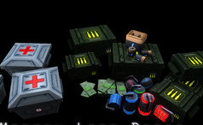
Extra Data Drops
At 11:30am and 2pm, teams will receive an “extra data drop”
There are two drop types: labels and features
Type of drop received at 11:30am is random across teams
At 2pm, the team will receive the other drop
In other words: at 2pm, everyone will have same data
Please do not share your drop with other teams!

Slide 18
Scoring/Validation @ \\CT01\Hackathon\scoringprogram.zip
Before you submit, \\CT01\hackathon\tlc2codalab.zip could convert TLC output to ScoringProgram’s format
Usage: ScoringProgram.exe [score|prepare] result_file
score: evaluate your labels for train dataset and provide accuracy number
example: ScoringProgram.exe score sample\TrainPredictions.tsv
prepare: ensures valid submission, creates submission zip with comment
example: ScoringProgram.exe prepare sample\submission.tsv
Submission file must have 2 columns: BugId and Path
Submission file must have header: BugID Path (tab-separated)
Submission file must have labels for all bugs in both training and test/validation sets (sample @ \\CT01\hackathon\Resources\SampleRunTLC\submission.tsv)
- A comment will be requested. It will only be visible to hackathon team. Please enter a short note describing what’s different about the submission vs. previous ones.

Slide 19
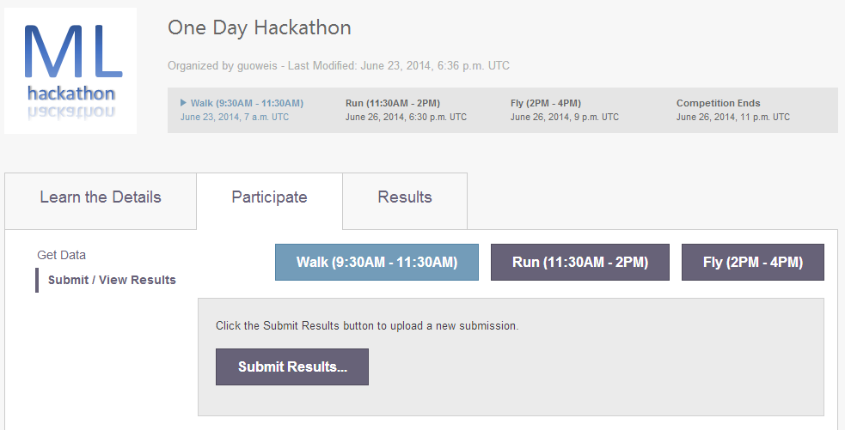
Codalab @ http://codalabtest.cloudapp.net/competitions/742

Slide 20
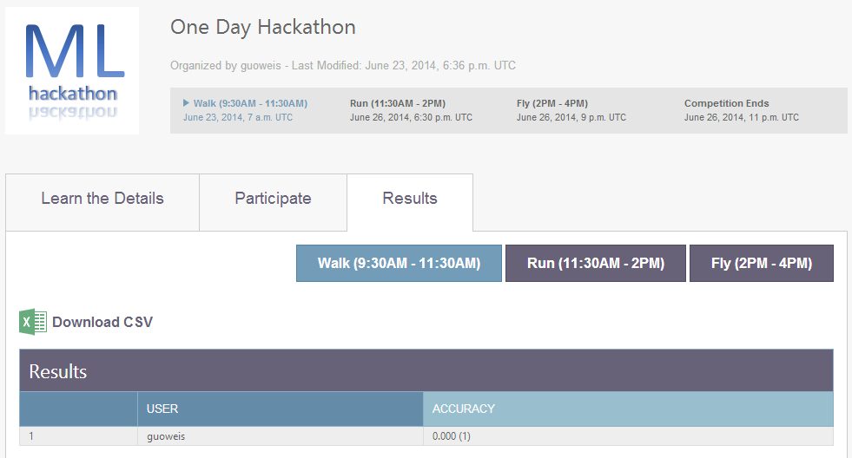
Codalab @ http://codalabtest.cloudapp.net/competitions/742

Slide 21
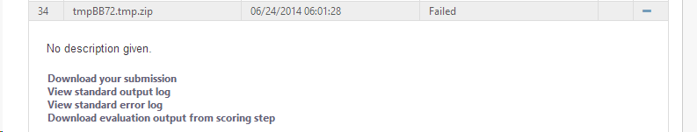
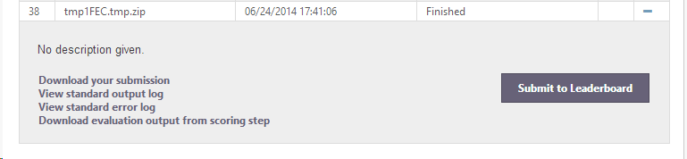
Codalab @ http://codalabtest.cloudapp.net/competitions/742
If anything goes wrong…
To publish your result

Slide 22
Almost time to get cracking…
Speed-dating! Let’s find you some team-mates!
All teams MUST register before getting started :
Freeform Track
REGISTER AT http://aka.ms/MLhack-freeform
Move to BAKER now
Back here by 4:30PM, after all demos
Contest Track
REGISTER AT http://aka.ms/MLhack-contest
Stay here in HOOD
Last submission at 4:00PM
Team member #1 of each registered team will receive an email with their Team Name, CodaLab Login (Contest Track only) & other instructions

Slide 23
Thanks!

